Slide 1
CS 170 Segment 8 Machine Learning 3
Notes based from Dr. Eamonn Keogh

Slide 2
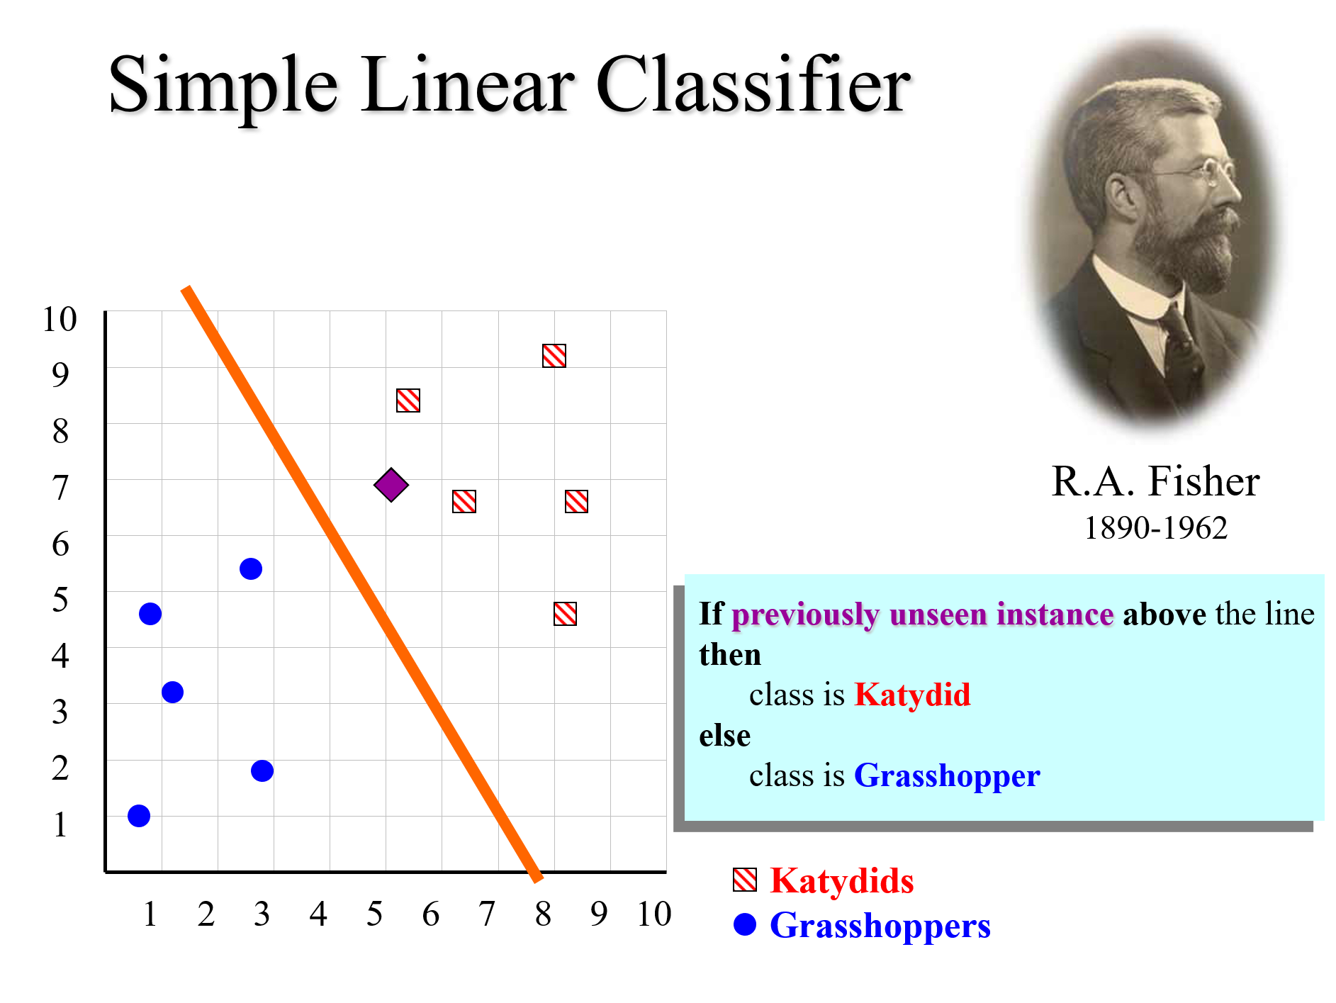
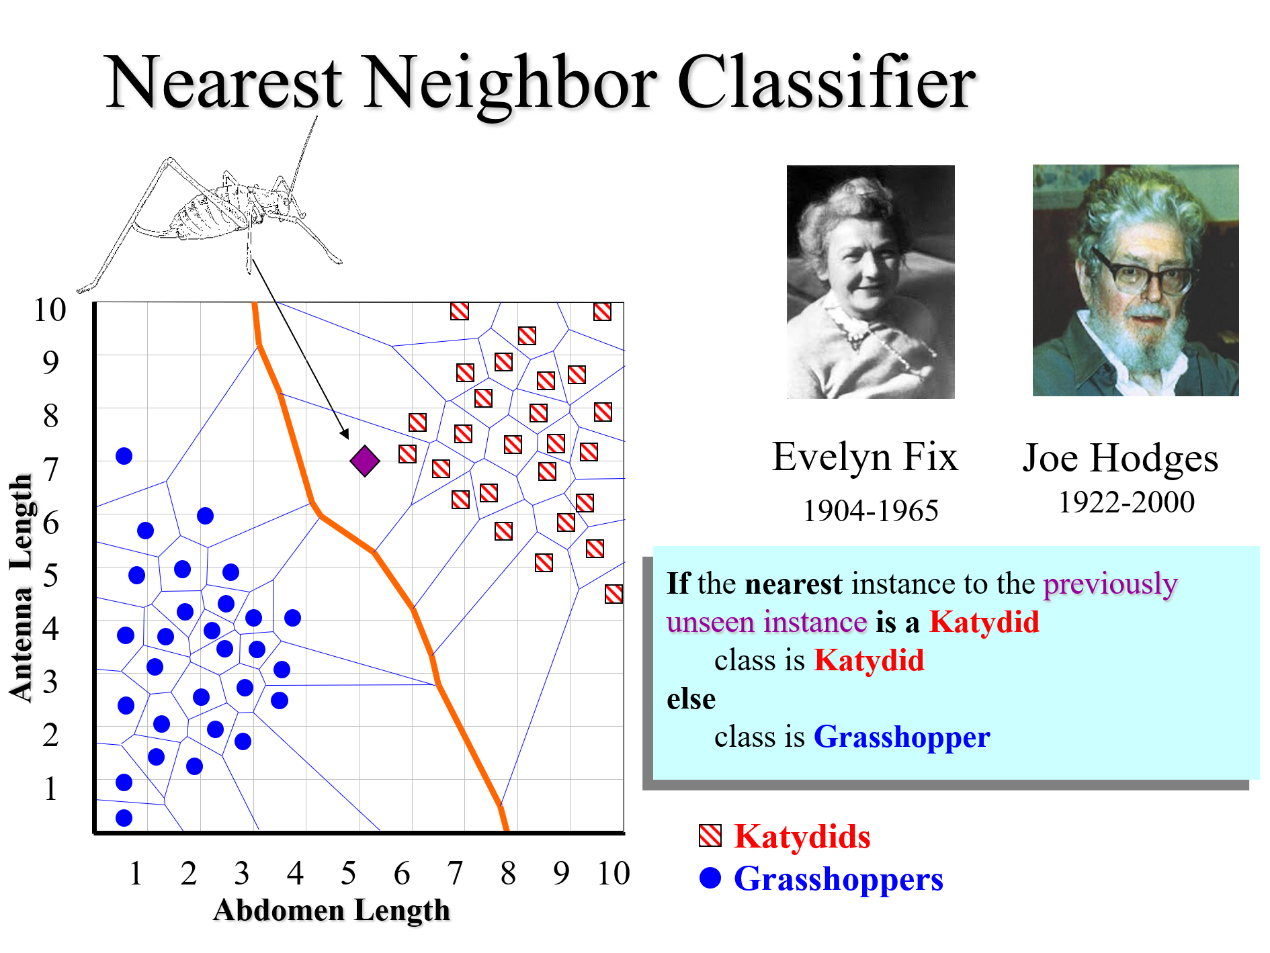
We have seen two classifications algorithms (the linear classifier, and nearest neighbor)

Slide 3
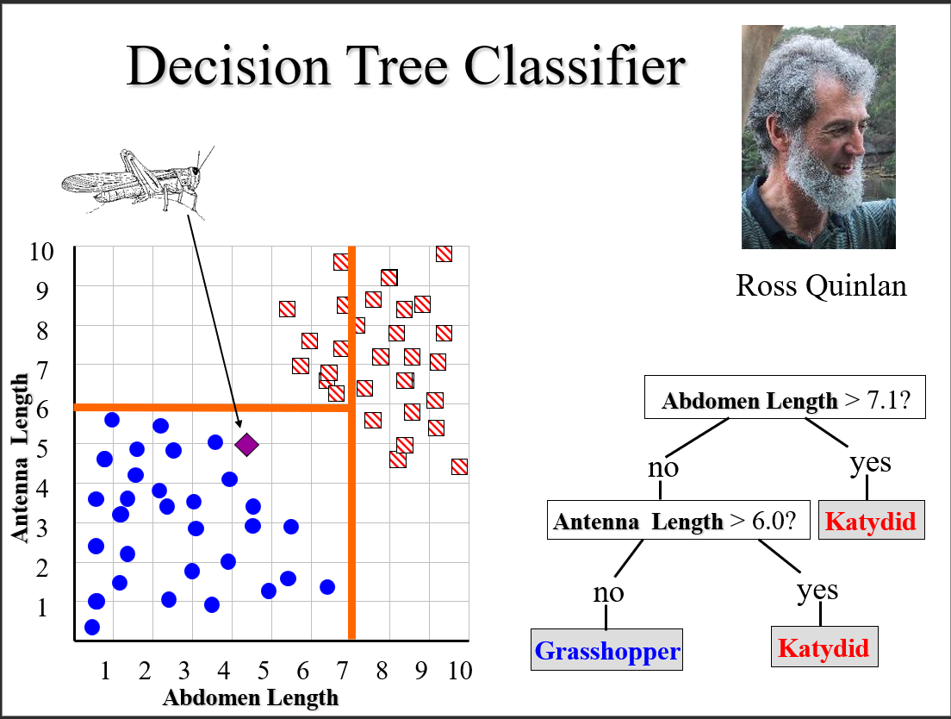

Slide 4
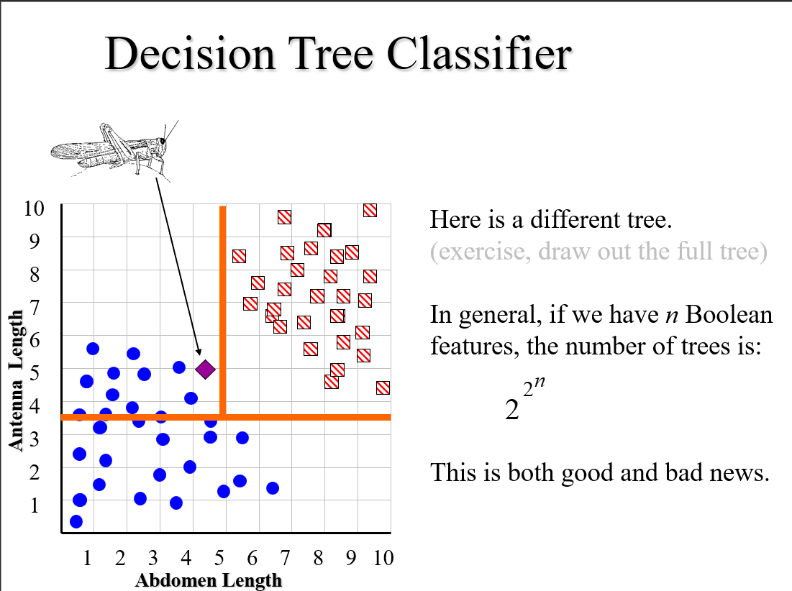

Slide 5
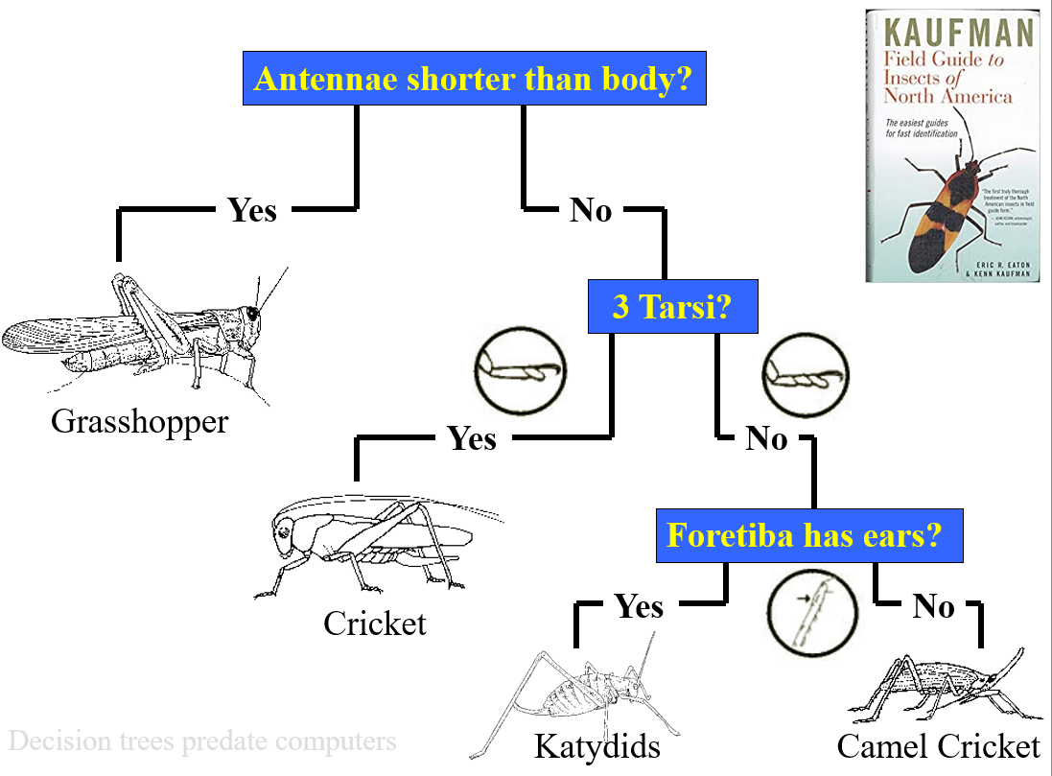

Slide 6
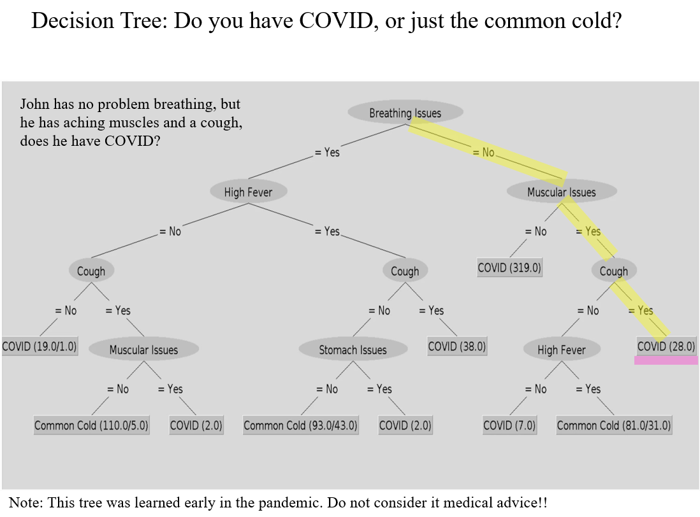

Slide 7
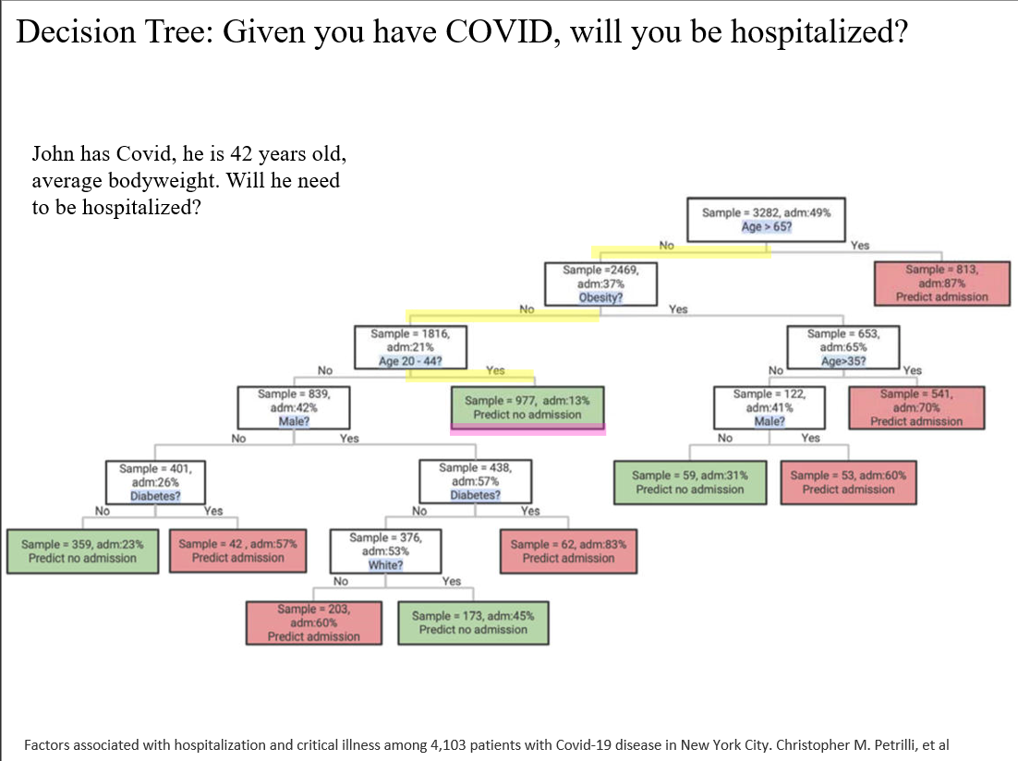

Slide 8
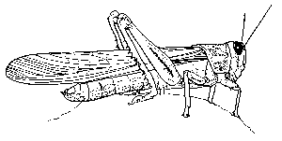



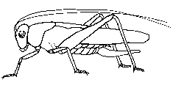
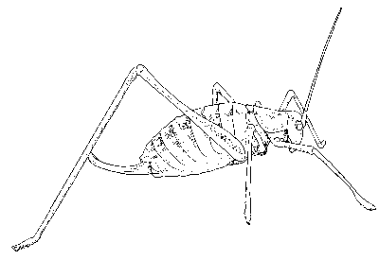

Decision Tree Classification
Antennae shorter than body?
Decision tree
-A flow-chart-like tree structure
-Internal node denotes a test on an attribute
-Branch represents an outcome of the test
-Leaf nodes represent class labels or class distribution
Decision Tree generation consists of two phases
-Tree construction
At start, all the training examples are at the root
Partition examples recursively based on selected attributes
-Tree pruning
Identify and remove branches that reflect noise or outliers
Yes
No
3 Tarsi?
Grasshopper
Yes
No
Foretiba has ears?
Cricket
Yes
No
Katydids
Camel Cricket

Slide 9
How do we construct the decision tree?
Basic algorithm (a greedy algorithm)
-Tree is constructed in a top-down recursive divide and conquer manner
-At start, all the training examples are at the root
=Attributes are categorical (if continuous-valued, they can be discretized in advanced)
-Examples are partitioned recursively based on selected attributes
=Test attributes are selected on the basis of a heuristic or statistical measure (e.g. information grain)
Conditions for stopping partitioning
-All samples for a given node belong to the same class
There are no remaining attributes for further partitioning – majority voting is employed for classifying the leaf
There are no samples left

Slide 10
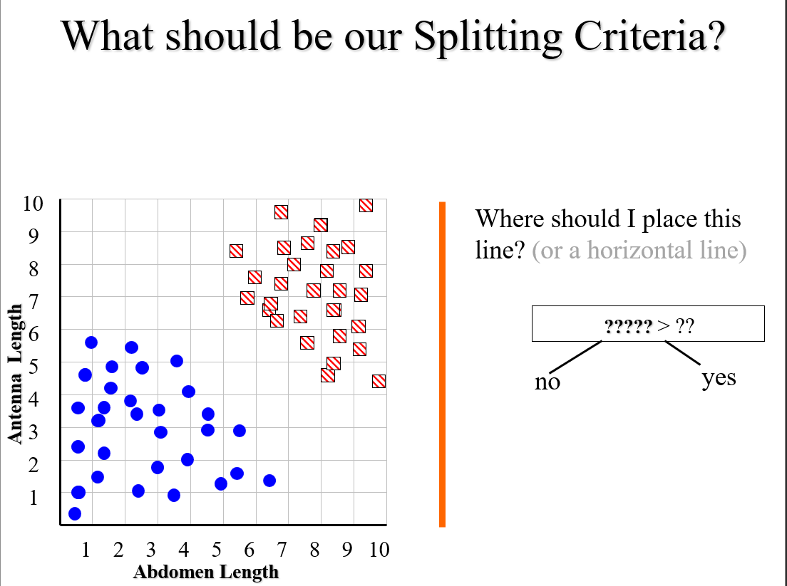

Slide 11
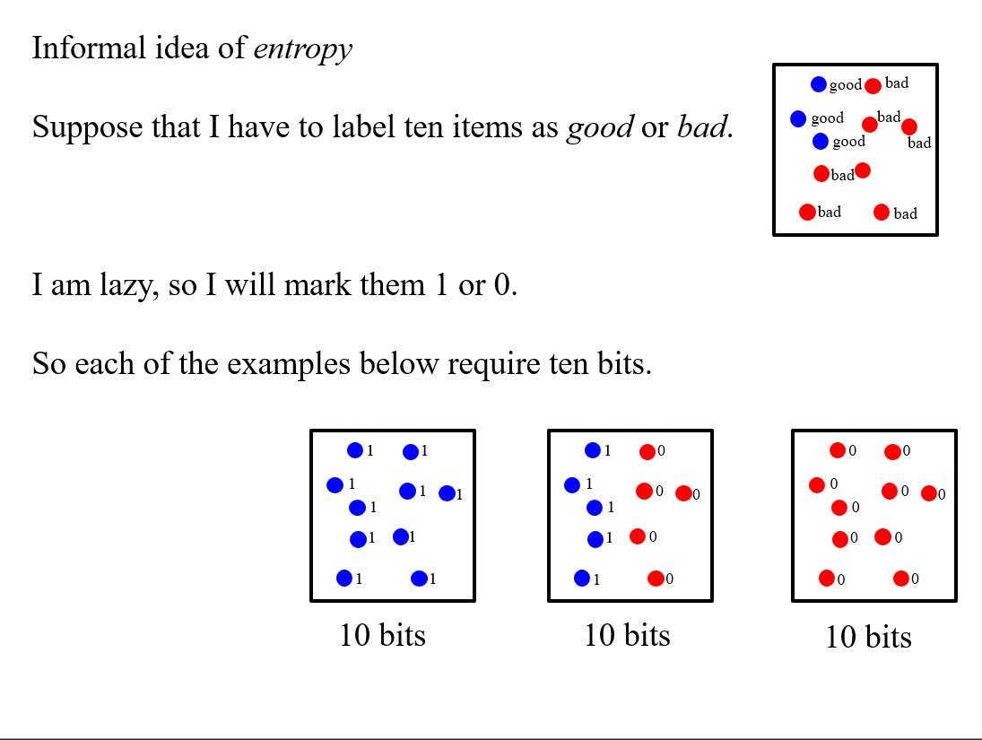

Slide 12
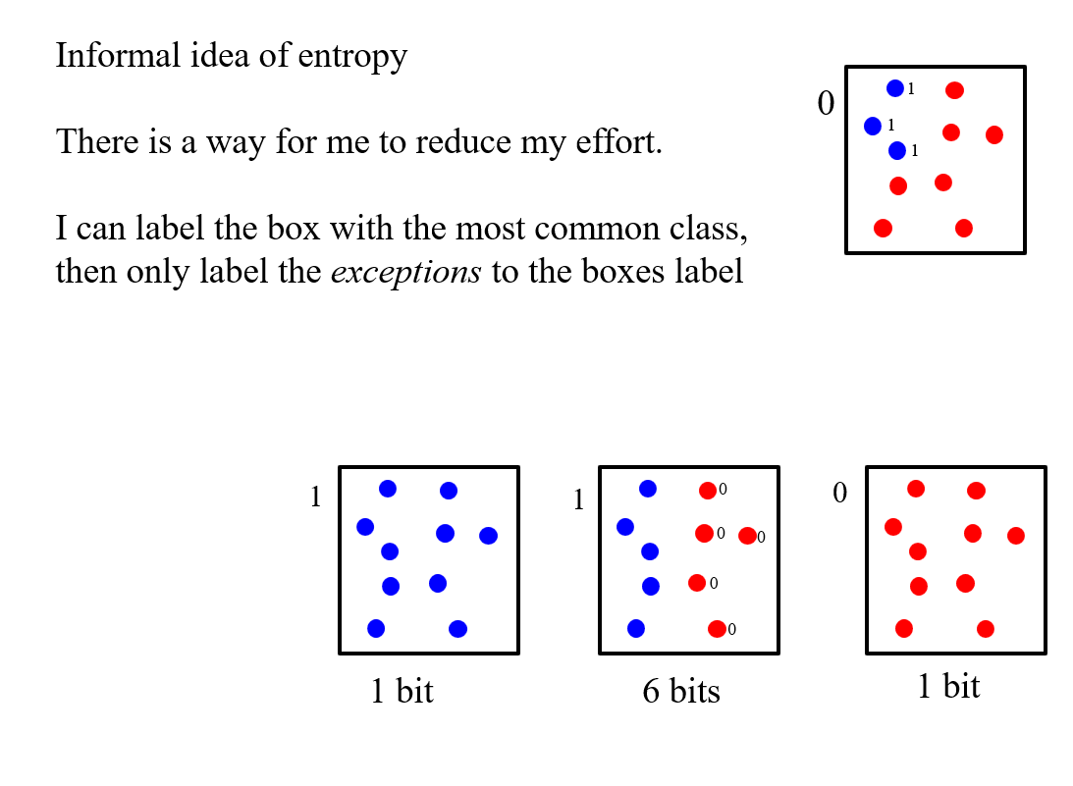

Slide 13
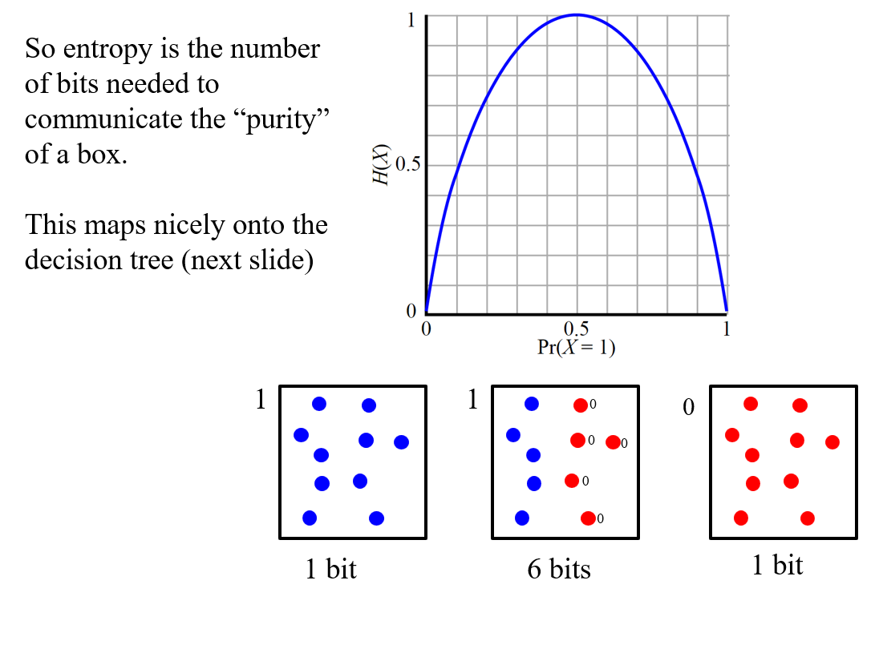

Slide 14
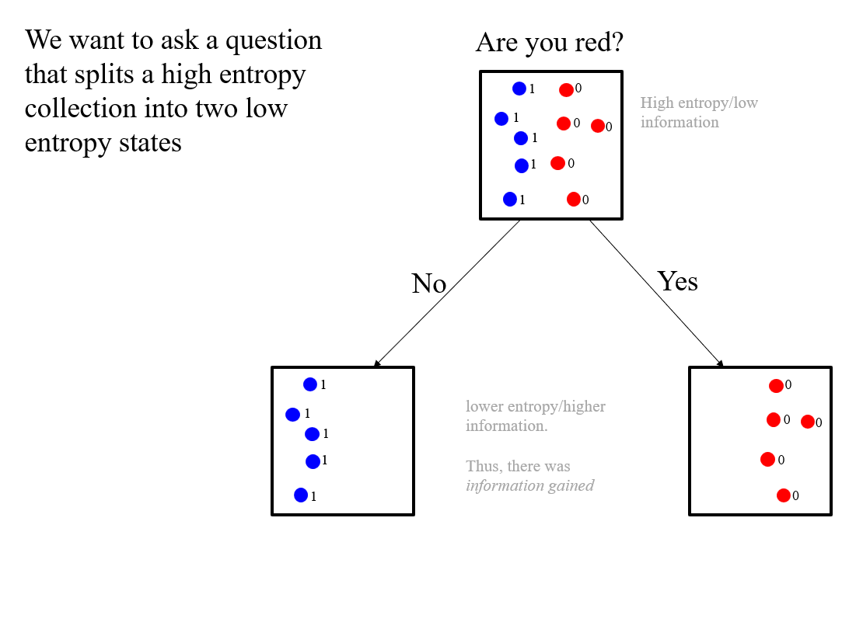

Slide 15
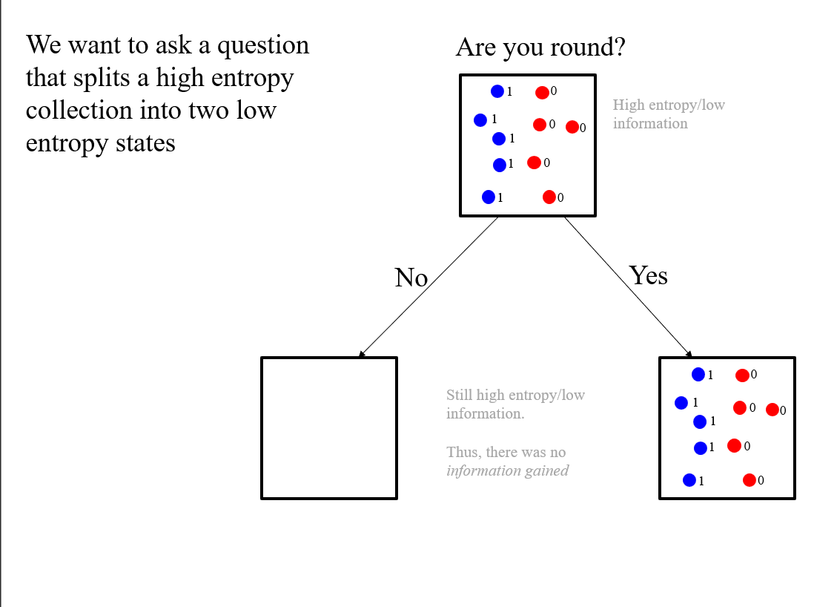

Slide 16
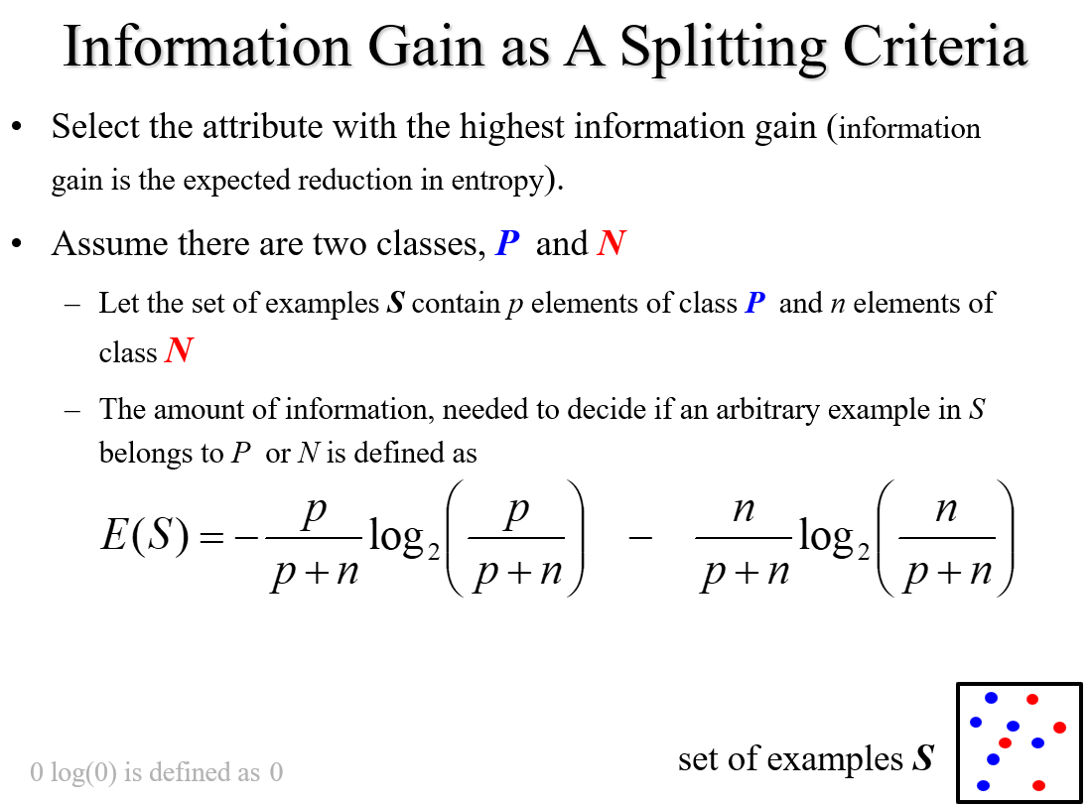

Slide 17
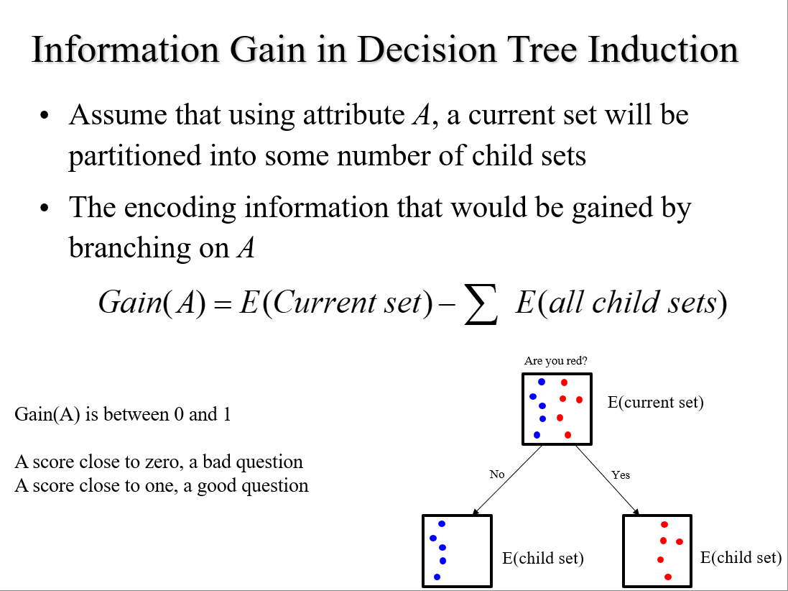

Slide 18
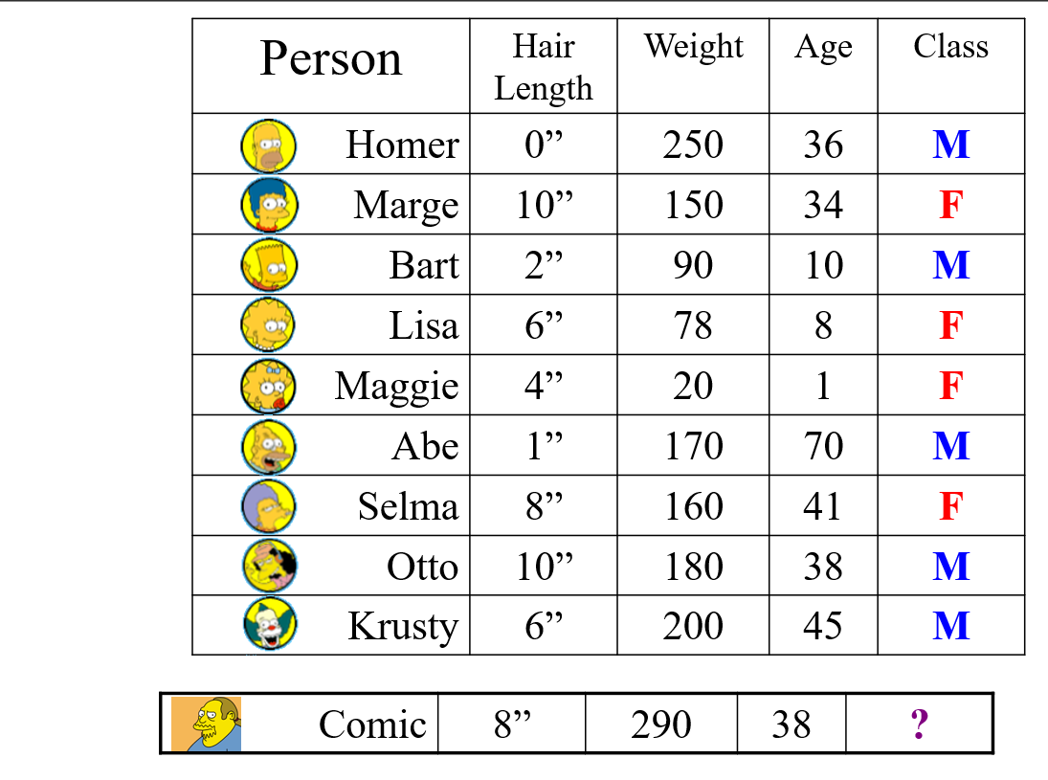

Slide 19
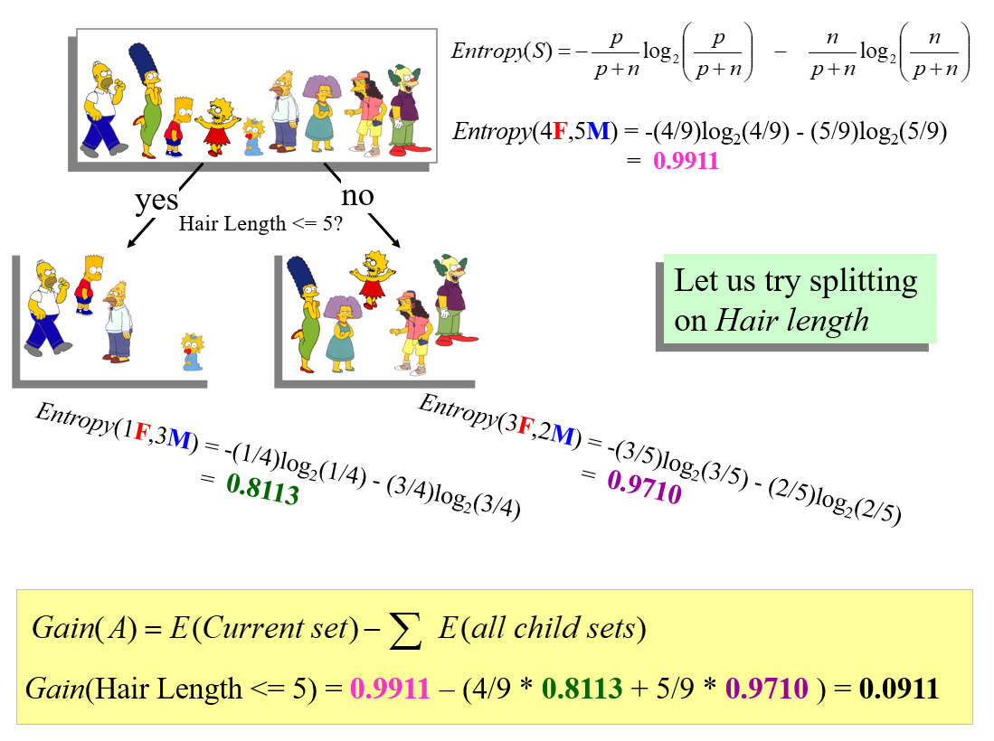

Slide 20
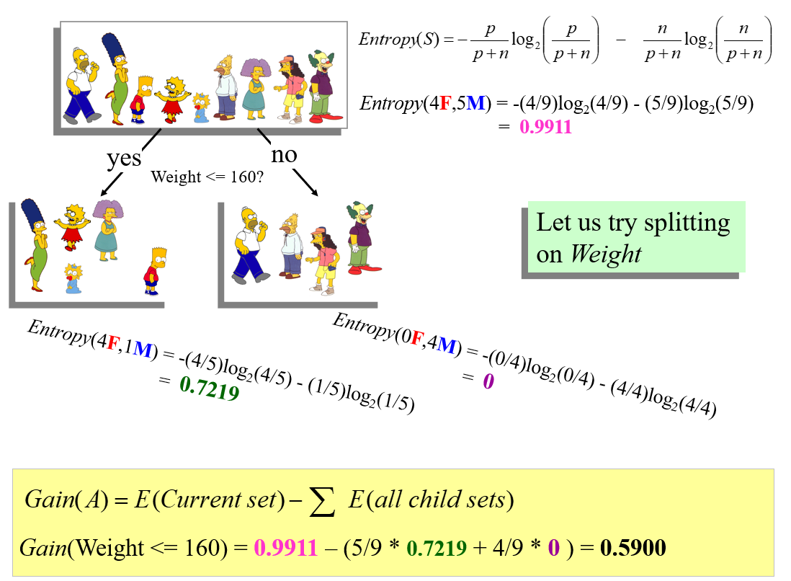

Slide 21
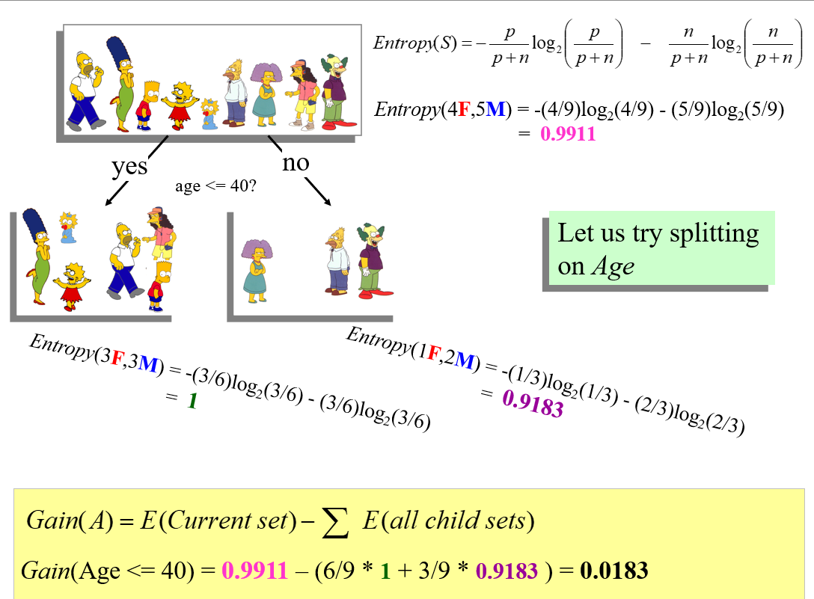

Slide 22
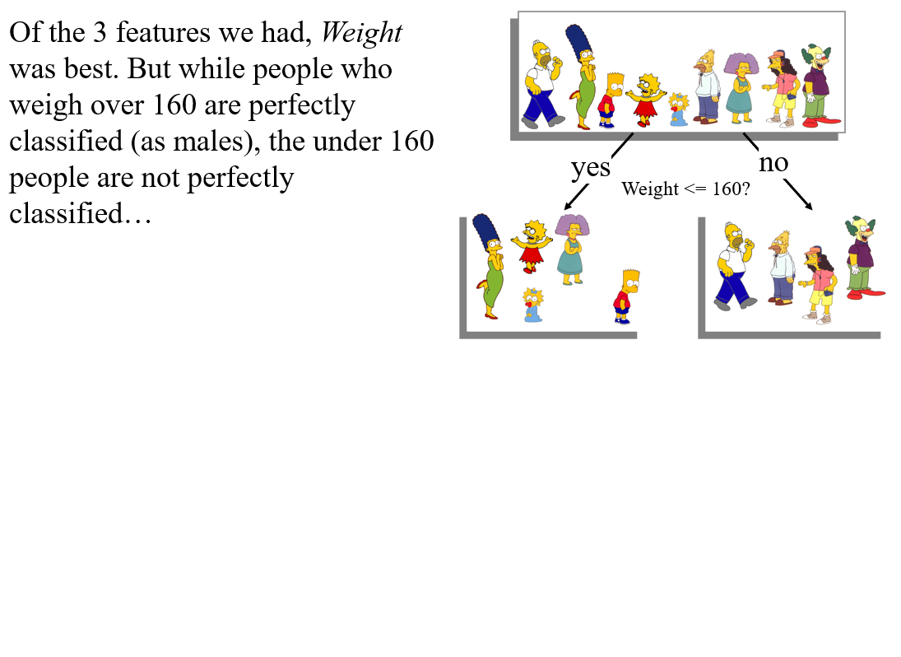

Slide 23
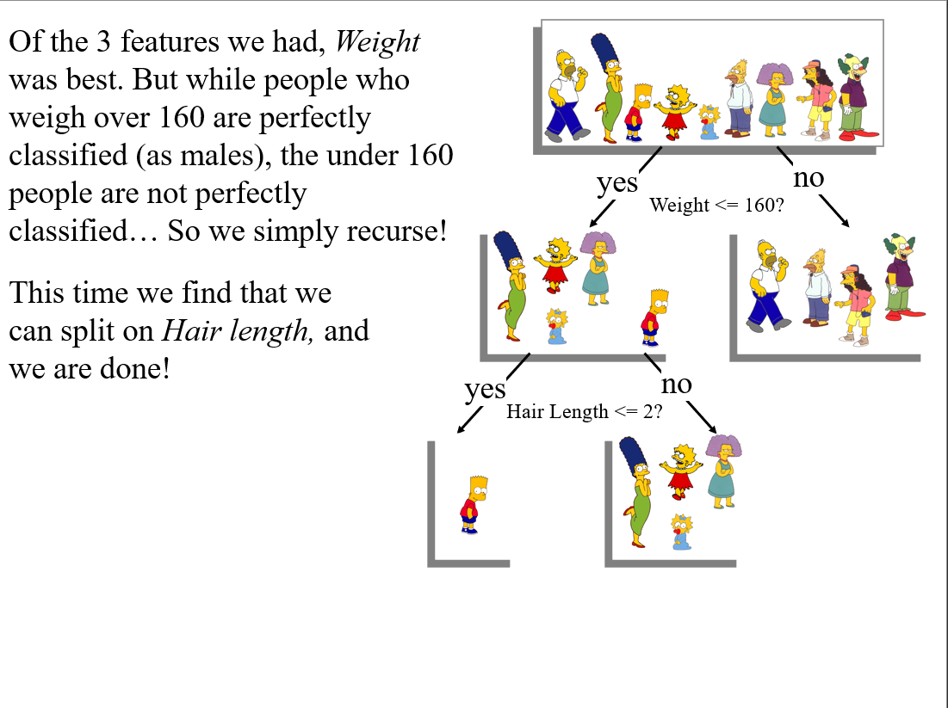

Slide 24
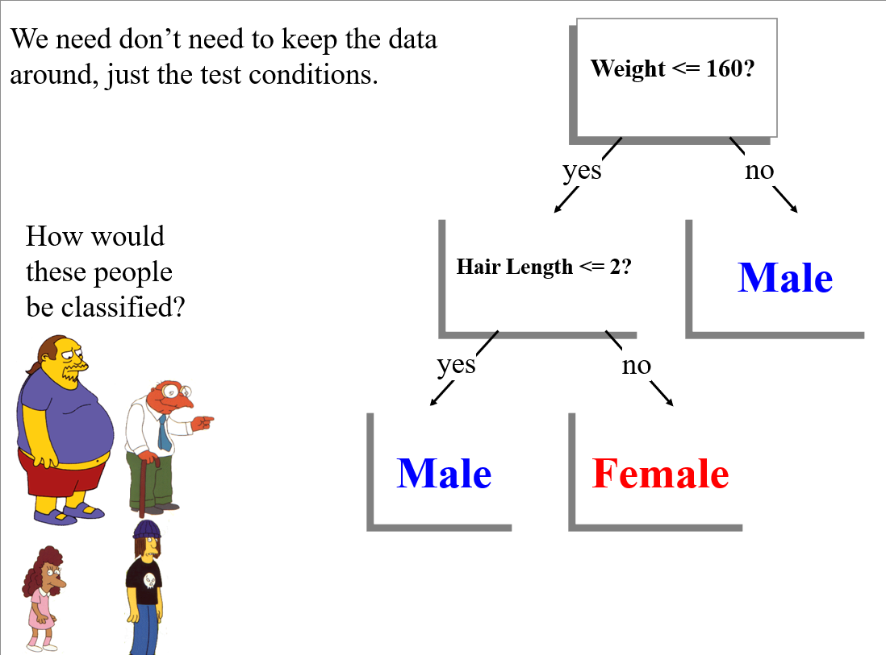

Slide 25
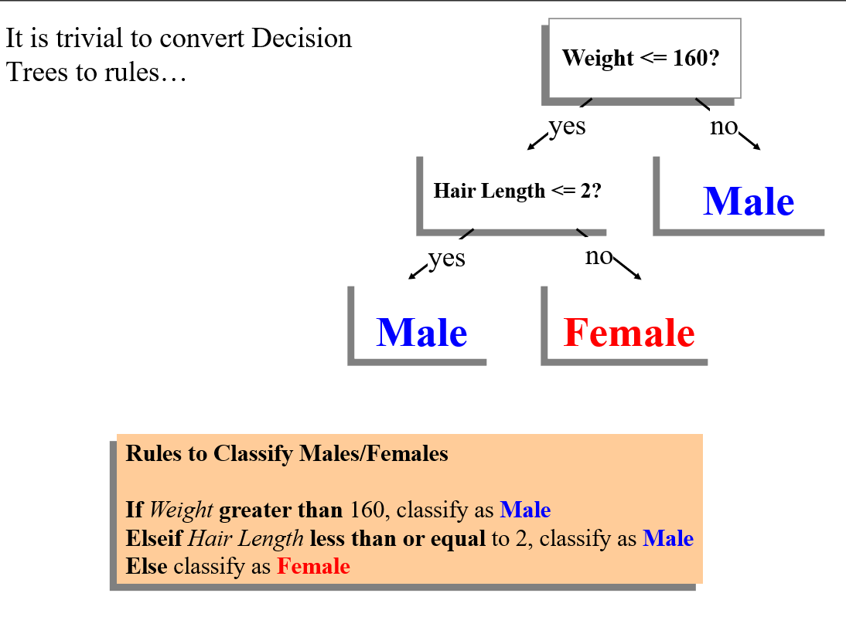

Slide 26
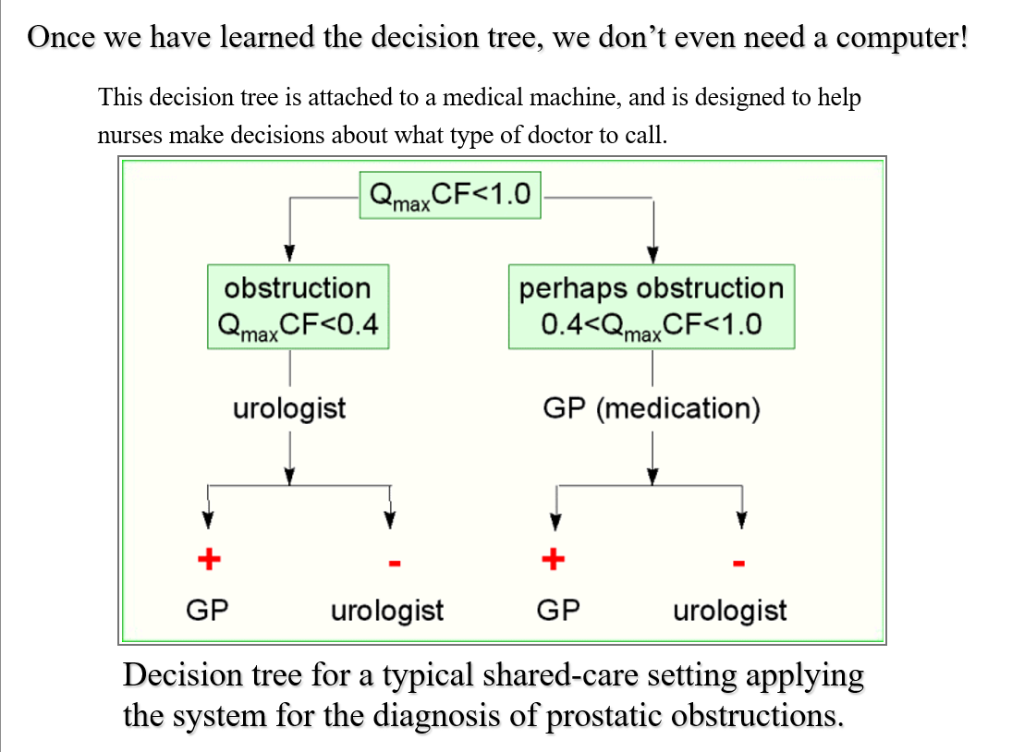

Slide 27
Classification Problem: Fourth Amendment Cases before the Supreme Court I
The Fourth Amendment (Amendment IV) to the United States Constitution is the part of the Bill of Rights that prohibits unreasonable searches and seizures and requires any warrant to be judicially sanctioned and supported by probable cause
Suppose we have a 4th amendment case, Keogh vs State of California. Keogh argues that the search that found evidence of him taking bribes was an Unreasonable search (U), and the state argues that the search was Reasonable search (R).
The case is appealed to the Supreme Court, will the court decide U or R?

Slide 28
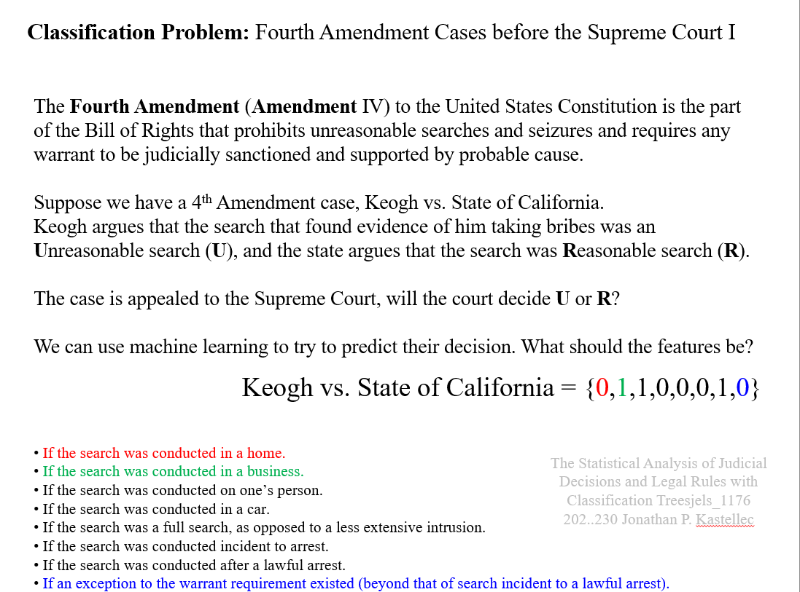

Slide 29
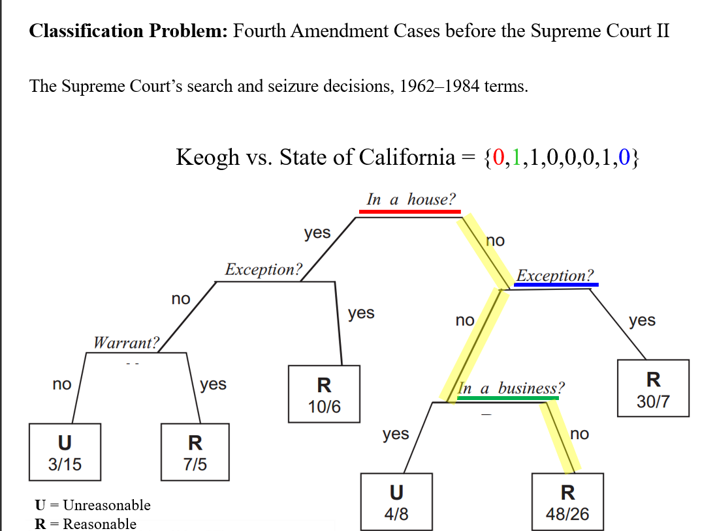

Slide 30
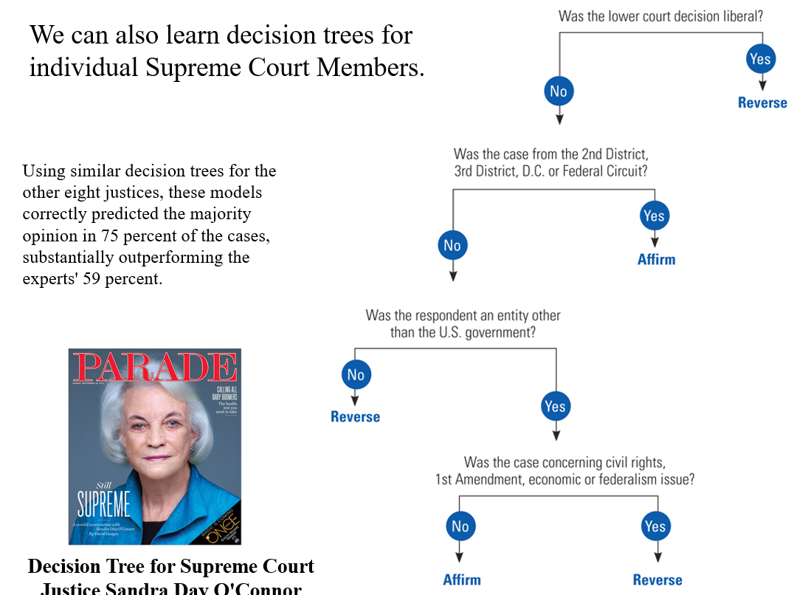

Slide 31
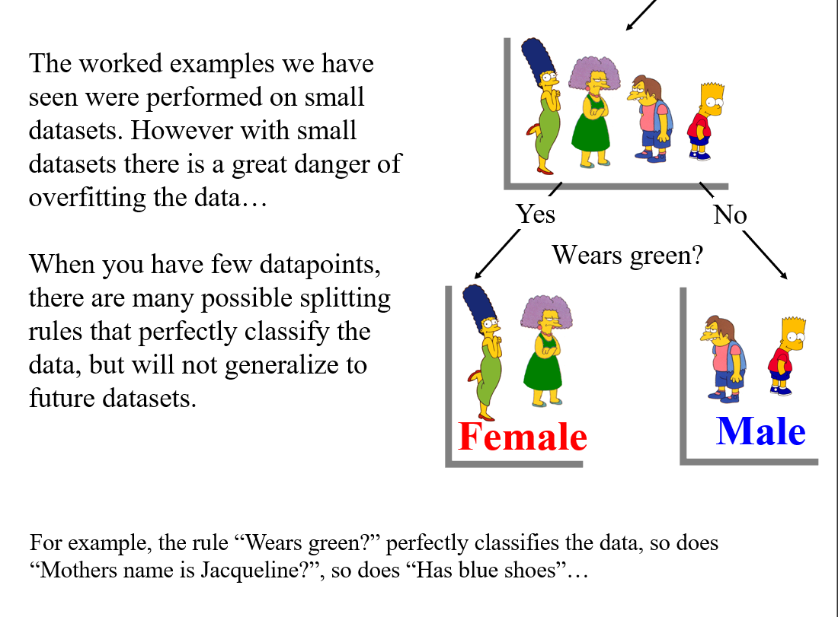

Slide 32
Avoid Overfitting in Classification
The generated tree may overfit the training data
-Too many branches, some may reflect anomalies due to noise or outliers
-Result is in poor accuracy for unseen samples
Two approaches to avoid overfitting
-Prepruning: Halt tree construction early – do not split a node if this would result in the goodness measure falling below a threshold
Difficult to choose an appropriate threshold
-Postpruning: Remove branches from a “fully grown: tree – get a sequence of progressively pruned trees
Use a set of data different from the training data to decide which is the “best pruned tree”

Slide 33
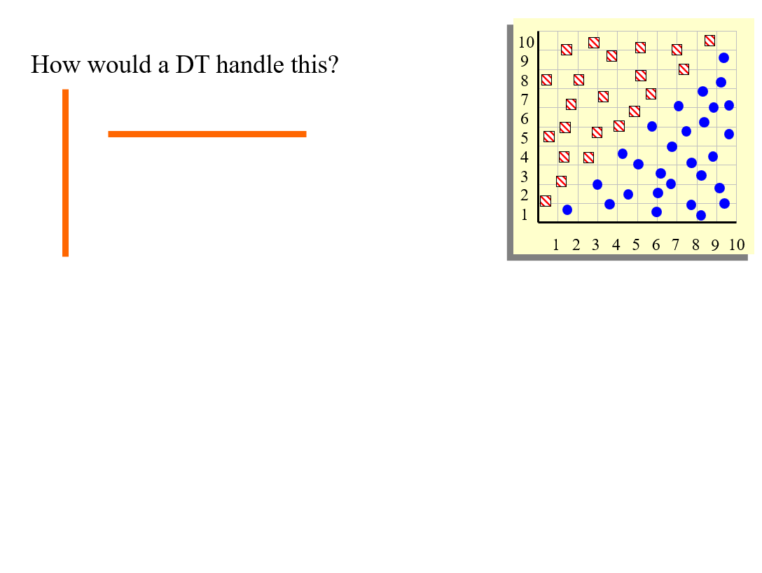

Slide 34
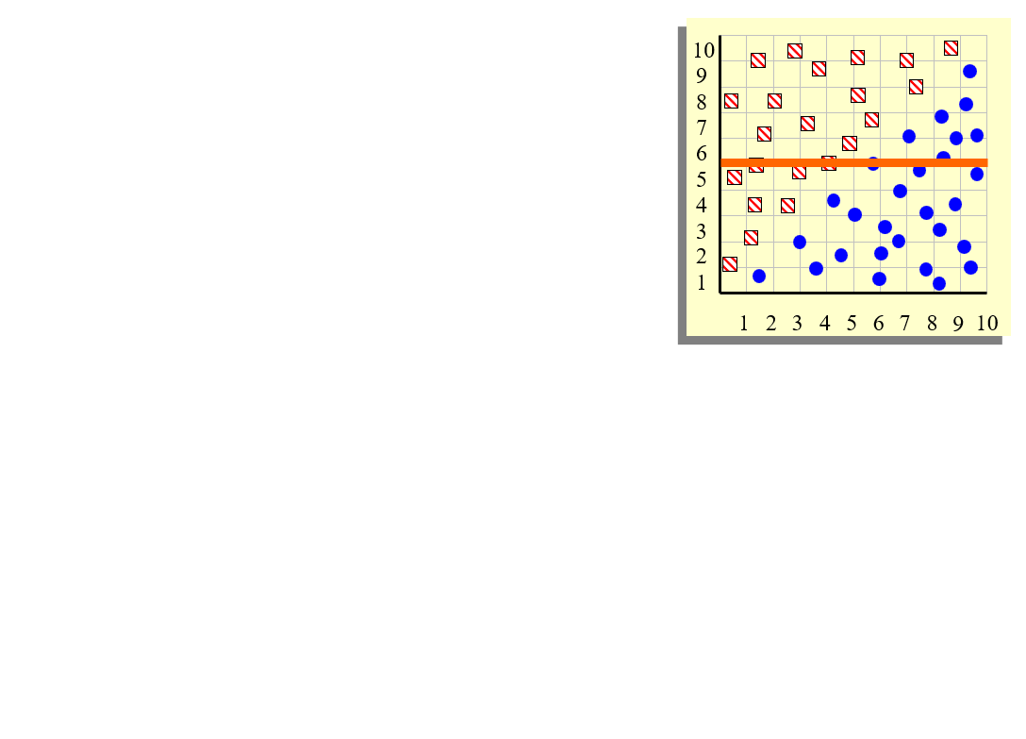

Slide 35
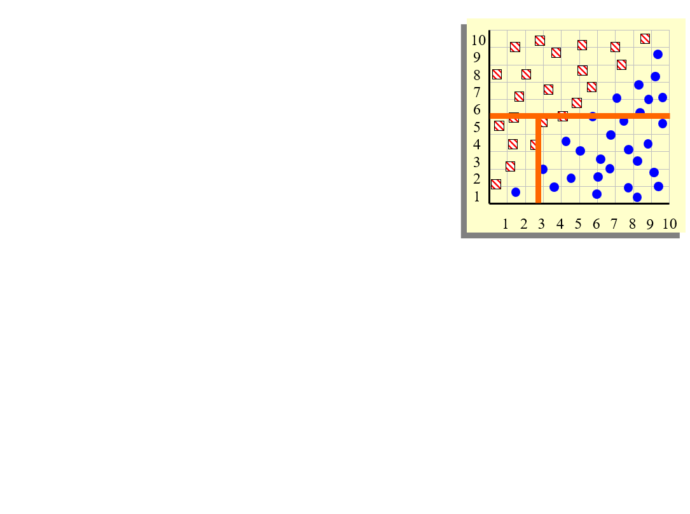

Slide 36
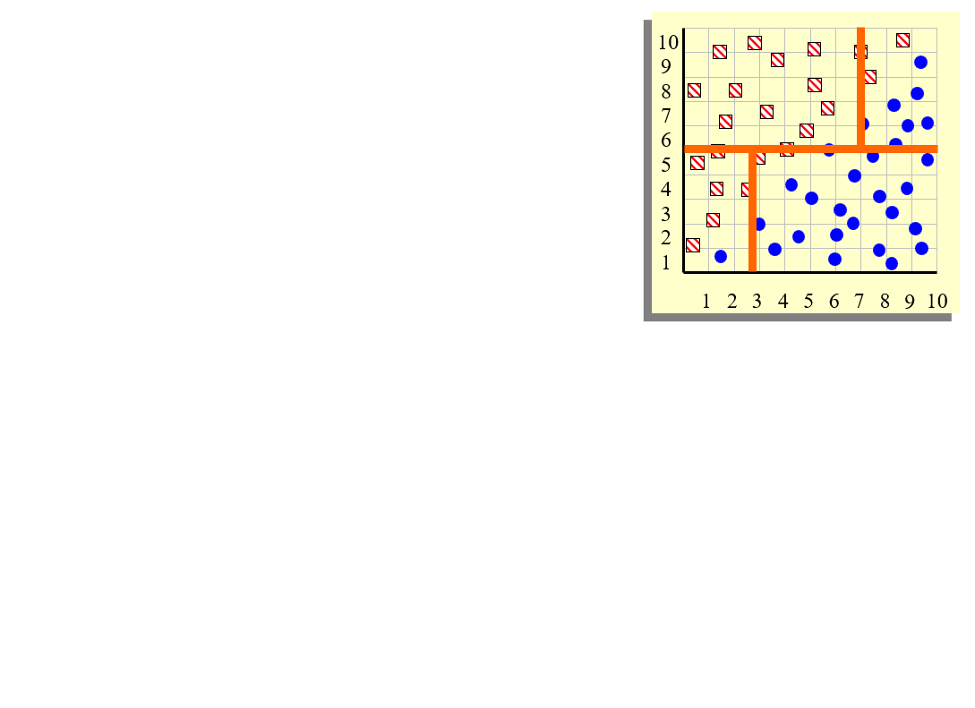

Slide 37
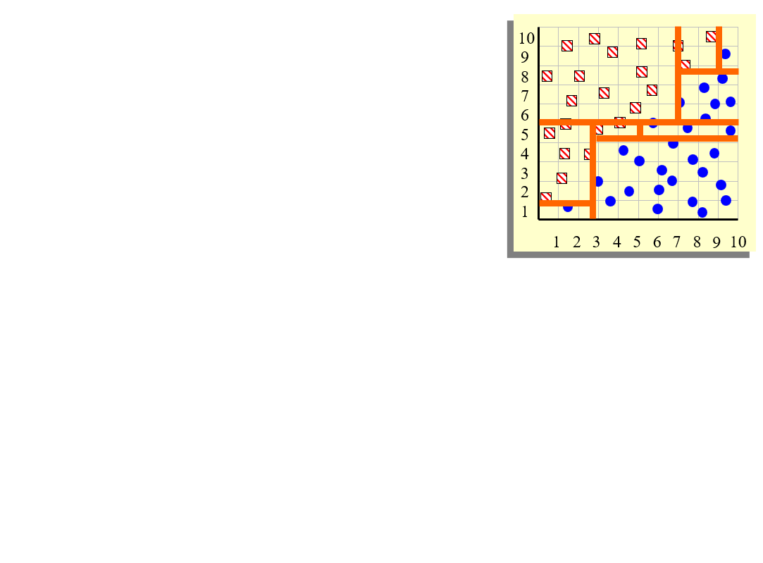

Slide 38
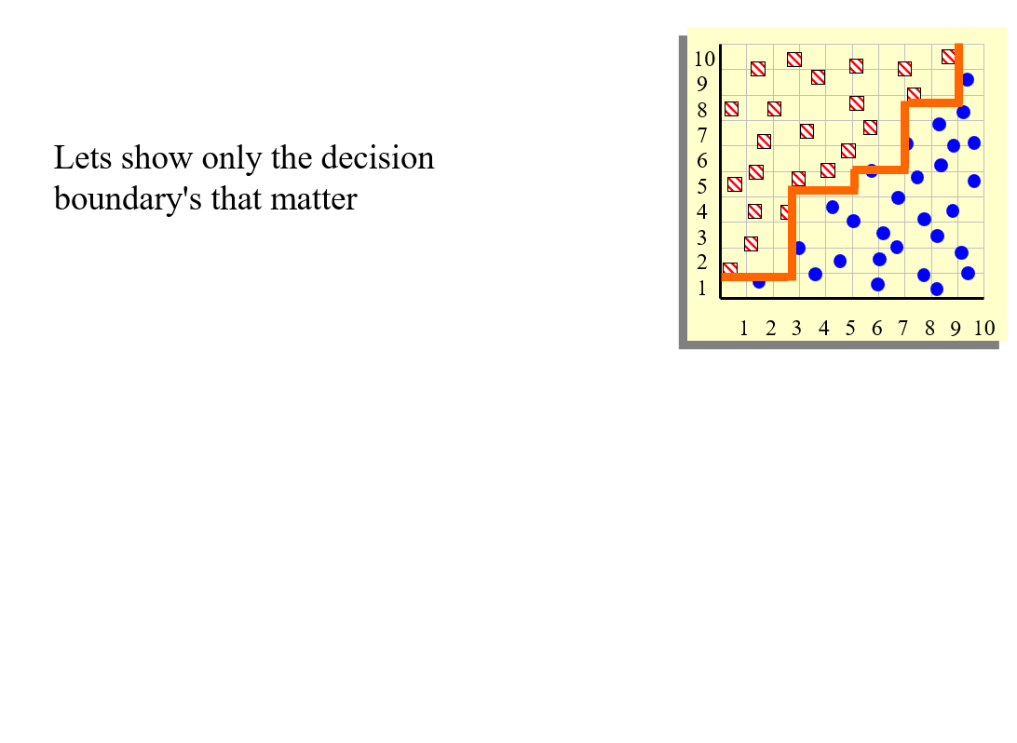

Slide 39
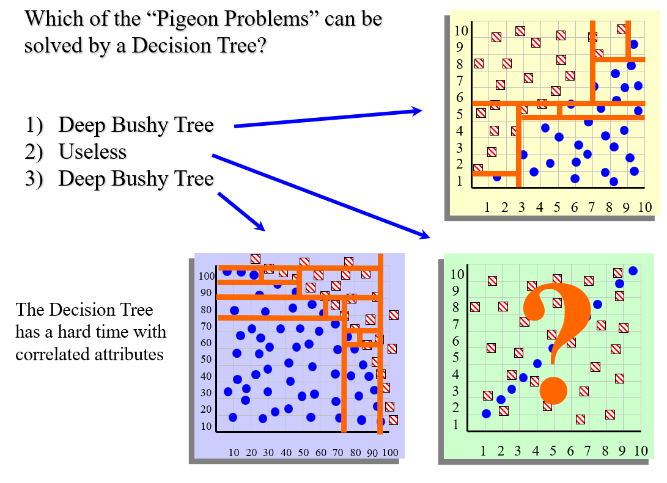

Slide 40
Advantages/Disadvantages of Decision Trees
Advantages:
-Easy to understand (Doctors love them!)
-Easy to generate rules
Disadvantages:
-May suffer from overfitting
-Classifies by rectangular partitioning (so does not handle correlated features very well)
-Can be quite large – pruning is necessary
-Does not handle streaming data easily

Slide 41
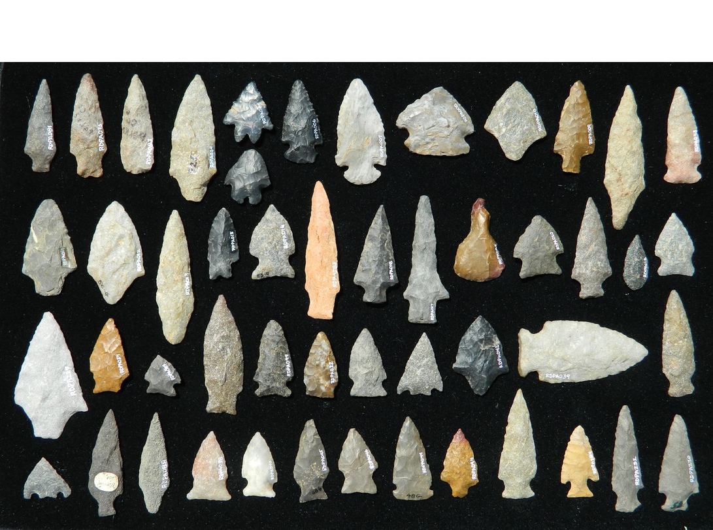

Slide 42
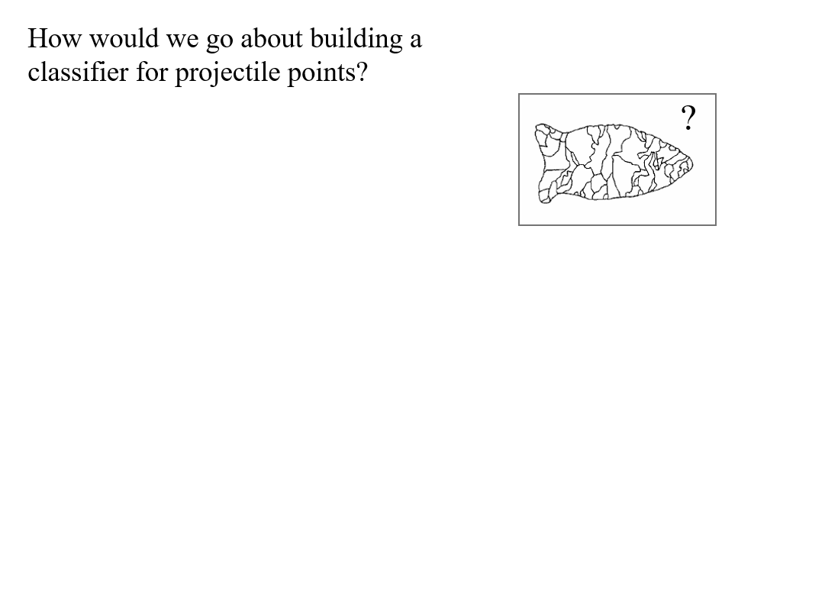

Slide 43
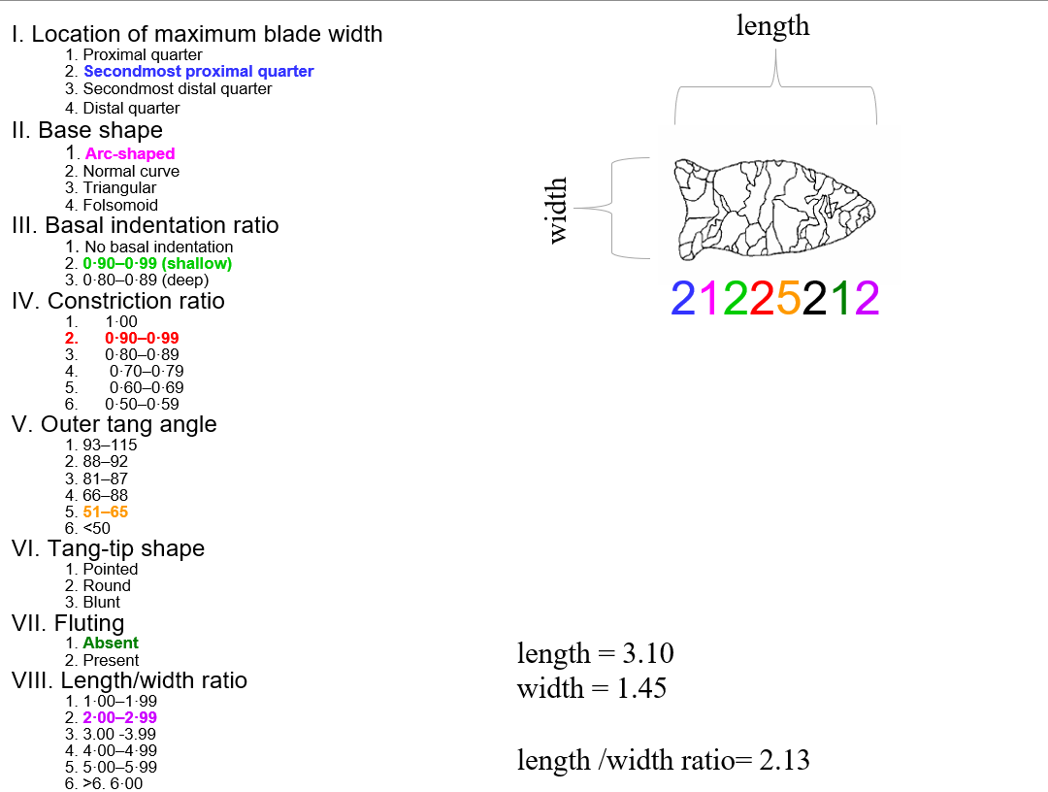

Slide 44
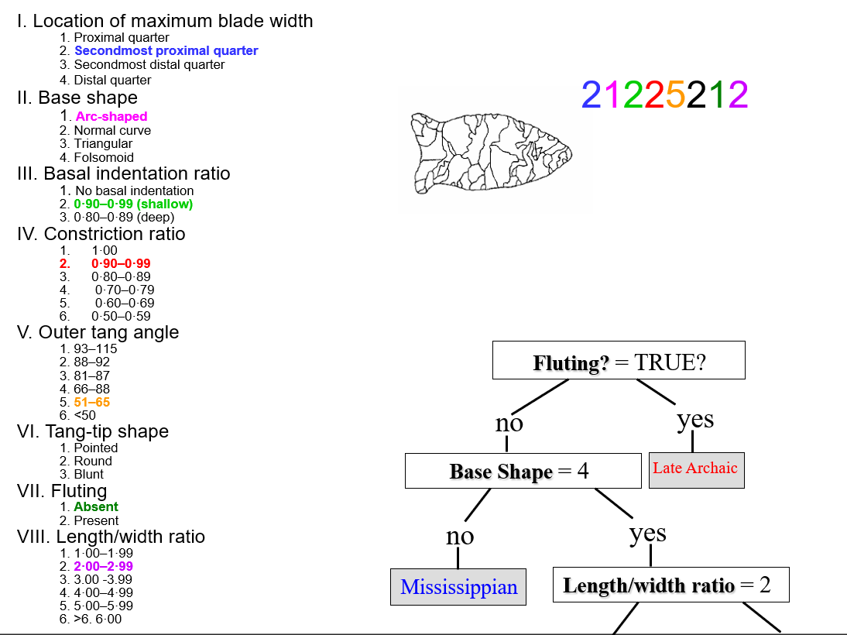

Slide 45
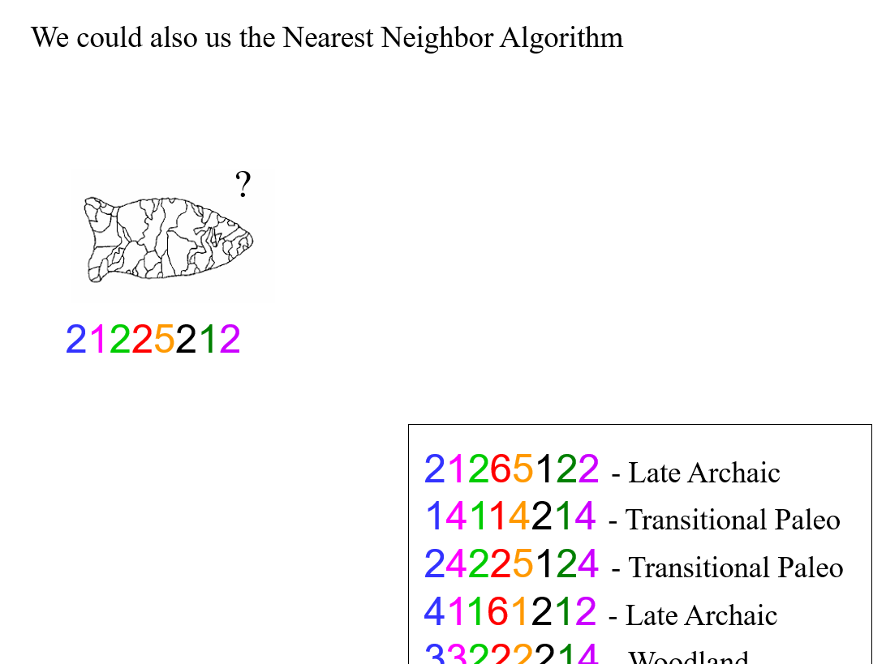

Slide 46
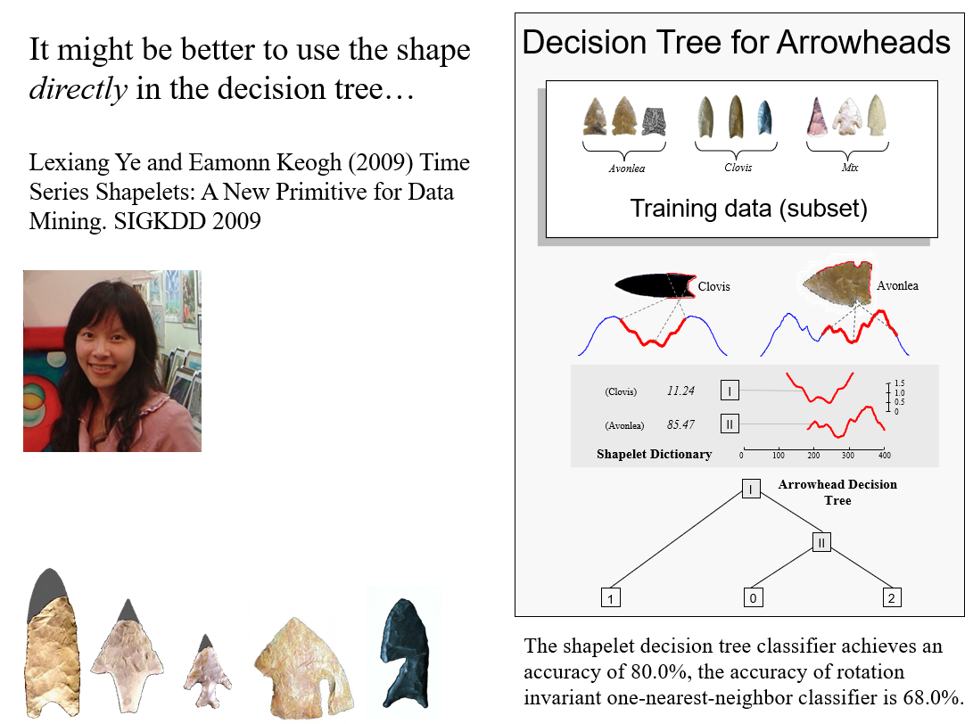

Slide 47
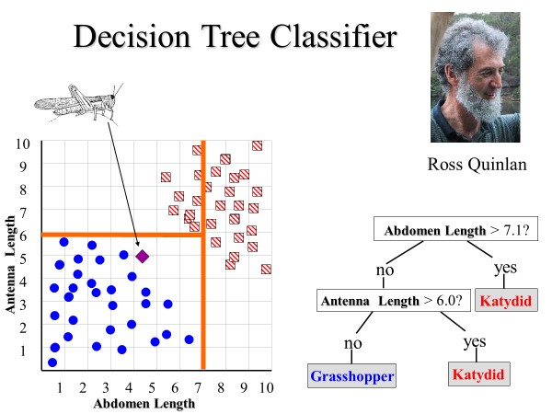
We have seen three classification algorithms (the linear classifier, nearest neighbor, and decision trees)
Lets see one more today, the Naïve Bayes Classifier

Slide 48
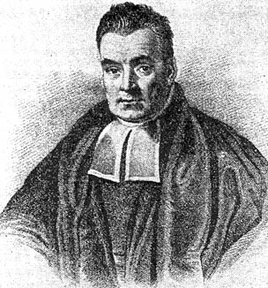
Naïve Bayes Classifier
Thomas Bayes
1702 - 1761
We will start off with a visual intuition, before looking at the math…

Slide 49
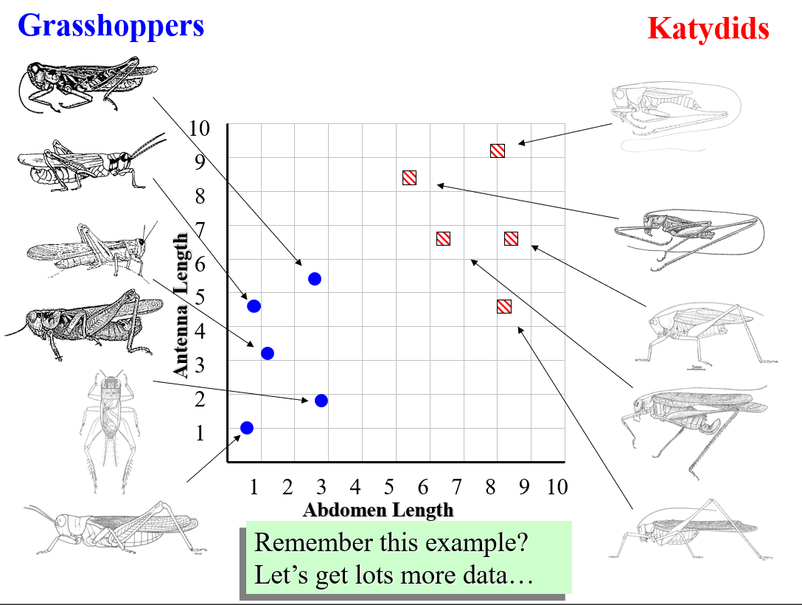

Slide 50
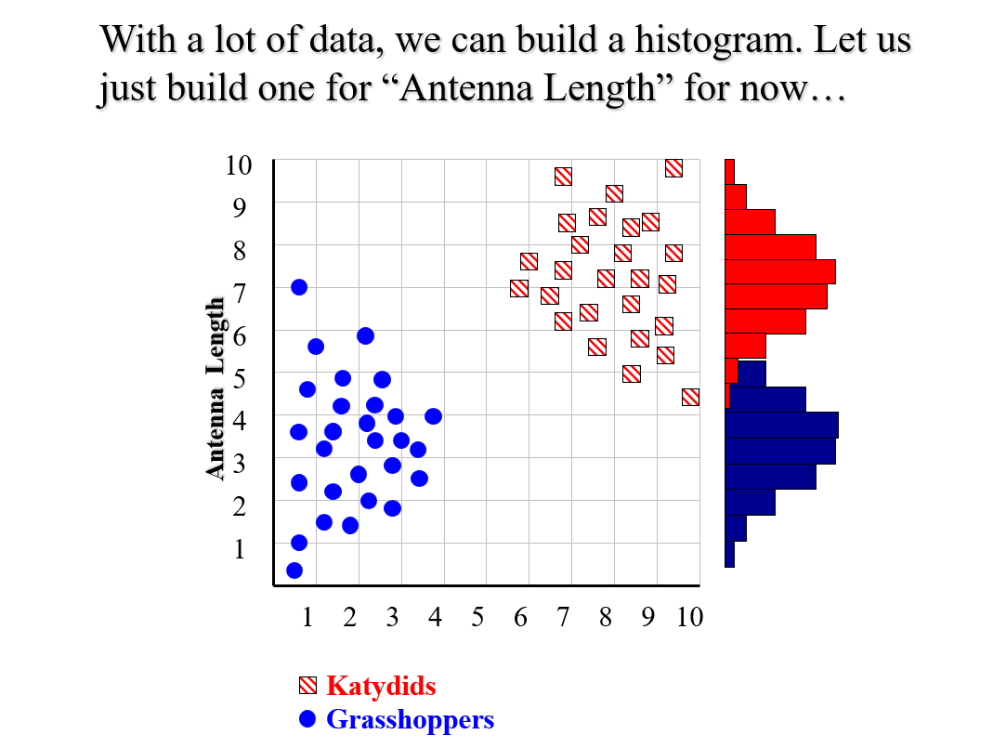

Slide 51
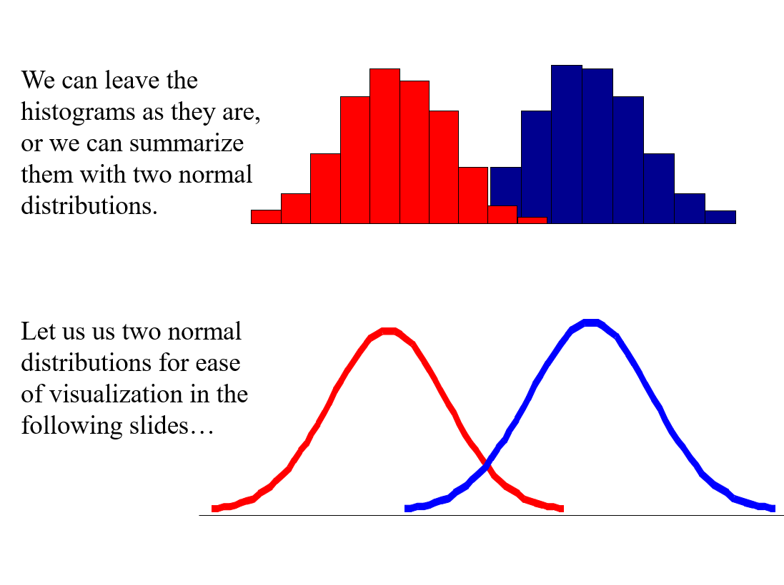

Slide 52
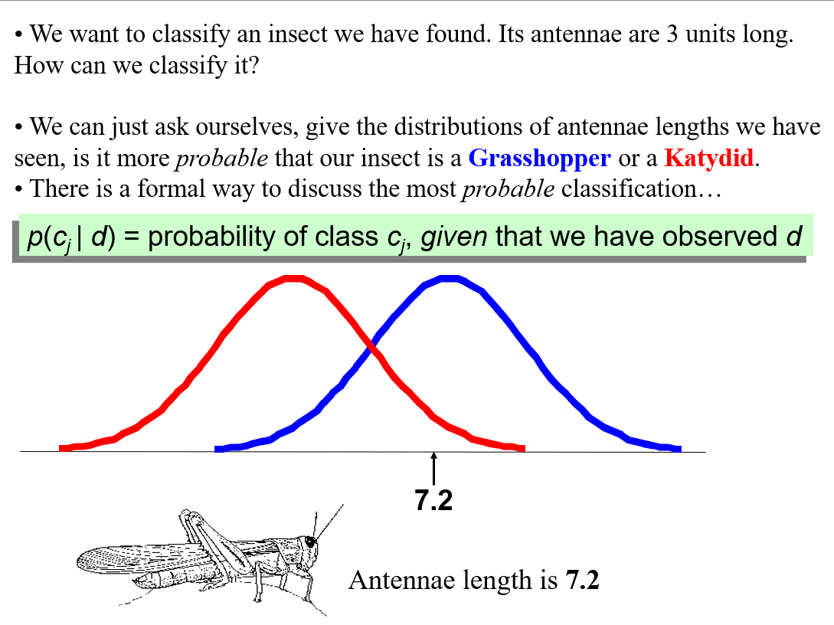

Slide 53


Slide 54


Slide 55


Slide 56


Slide 57
Bayes Classifiers
That was a visual intuition for a simple case of the Bayes classifier, also called
Idiot Bayes
Naïve Bayes
Simple Bayes
We are about to see some of the mathematical formalisms and more examples, but keep in mind the basic idea
Find out the probability of the previously unseen instance belonging to each class, then simply pick the most probable class

Slide 58


Slide 59


Slide 60


Slide 61


Slide 62


Slide 63


Slide 64


Slide 65


Slide 66


Slide 67


Slide 68


Slide 69


Slide 70


Slide 71


Slide 72


Slide 73


Slide 74


Slide 75


Slide 76


Slide 77


Slide 78


Slide 79


Slide 80
At the risk of being self indulgent, lets see an examples of Bayesian Classification in action…

Slide 81


Slide 82


Slide 83


Slide 84


Slide 85


Slide 86


Slide 87


Slide 88


Slide 89


Slide 90


Slide 91


Slide 92


Slide 93


Slide 94


Slide 95


Slide 96


Slide 97



Slide 98
Blue Sky Ideas
Once you have a classifier working, you begin to see new uses for them…
Let us see some examples..

Slide 99


Slide 100


Slide 101


Slide 102


Slide 103


